Slide 1
AI / LLM-based Agents & Security

Slide 2

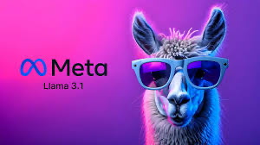
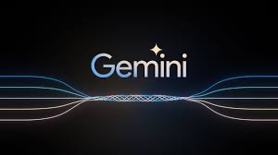


LLMs

Slide 3

LLM & Agent
ChatGPT

Slide 4
LLM & Agent
“Help me plan a 3-day trip to New York City.”
ChatGPT

Slide 5
LLM & Agent
“Here’s a suggested itinerary:
Day 1: Visit Times Square, Central Park, and the MET.
Day 2: Explore the Statue of Liberty and the Brooklyn Bridge.
Day 3:…”
“Help me plan a 3-day trip to New York City.”
ChatGPT

Slide 6

LLM & Agent
“Help me plan a 3-day trip to New York City.”
ChatGPT-based
Agent

Slide 7

LLM & Agent
“Help me plan a 3-day trip to New York City.”
ChatGPT-based
Agent
Understanding

Slide 8




LLM & Agent
“Help me plan a 3-day trip to New York City.”
ChatGPT-based
Agent
Understanding
(ChatGPT)
Data Retrieval
and Action

Slide 9

LLM & Agent
“Help me plan a 3-day trip to New York City.”
ChatGPT-based
Agent
Understanding
(ChatGPT)
Data Retrieval
and Action
Plan Personalization

Slide 10

LLM & Agent
“Help me plan a 3-day trip to New York City.”
ChatGPT-based
Agent
Understanding
(ChatGPT)
Data Retrieval
and Action
Monitor weather changes or
schedule conflicts and notify
with alternatives…
Updating
Plan Personalization

Slide 11
What is an Agent?
An AI/LLM-based agent can be defined as an application that attempts to achieve a goal by observing the world and acting upon it using the tools that it has at its disposal
Agents are autonomous and act independently of human intervention; they can reason about what they should do next to achieve the ultimate goal

Slide 12
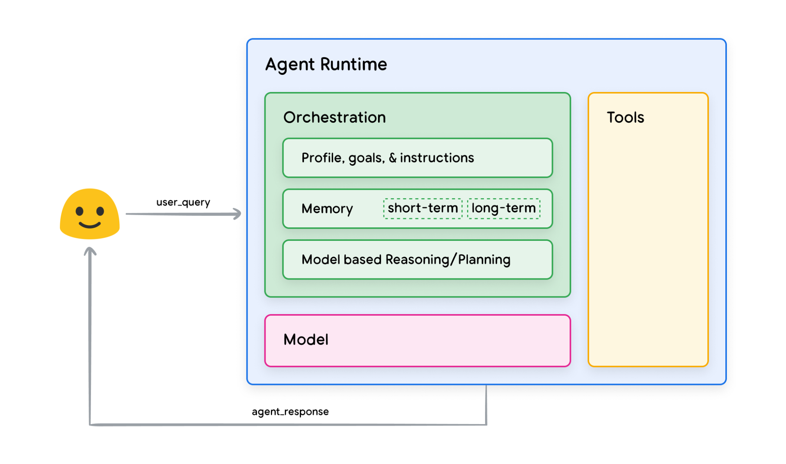
Foundational Components of an Agent
The foundational components that drive the agent’s behavior, actions, and decision making
Three essential components:
Model
Tools
Orchestration Layer
Google. Agents – white paper.

Slide 13
Foundational Components of an Agent
The Model:
Refers to the language model (LM) that will be utilized as the centralized decision maker for agent processes
The model in an agent can be one or multiple LM’s of any size that can instruction based reasoning and logic frameworks

Slide 14
Foundational Components of an Agent
The Tools:
Foundation models remain constrained by the inability to interact with the outside world
Tools bridge the gap, empowering agents to interact with external data and services
Typically align with web API methods
E.g., a tool can update customer information in a database or fetch weather data to influence a travel recommendation

Slide 15
Foundational Components of an Agent
The Orchestration Layer:
Describes a cyclical process that governs how the agent takes in information, performs internal reasoning, and then inform its next action or decision
In general, the loop will continue until the agent reaches its goal or a stop point

Slide 16
Capabilities of Agents
Tool Utilization
Advanced Reasoning
Tailored Generation
Levels of Autonomy
Integration with Other AI systems

Slide 17
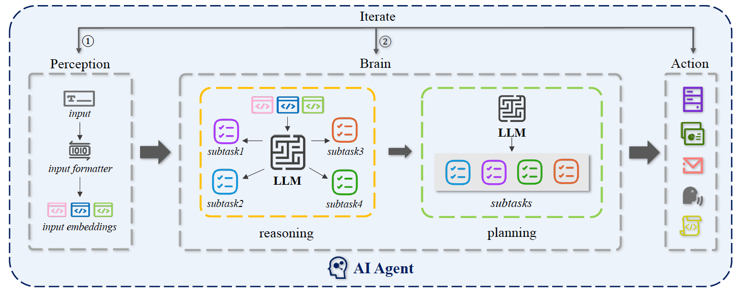
Conceptual Framework of AI Agent
Swinburne University of Technology. AI Agents Under Threat: A Survey of Key Security Challenges and Future Pathways.

Slide 18
Conceptual Framework of AI Agent
Notes:
Perception: enhance the quality of user input through prompt engineering

Slide 19
Conceptual Framework of AI Agent
Notes:
Reasoning refers to a large language model designed to analyze and deduce information, helping to draw logical conclusions from given prompts
Planning, on the other hand, denotes a large language model tailored to assist in making strategies and decisions by evaluating possible outcomes and optimizing for specific objectives.
The combination of LLMs for planning and reasoning is called the brain

Slide 20
Conceptual Framework of AI Agent
Notes:
External tool callings are together named as the action

Slide 21
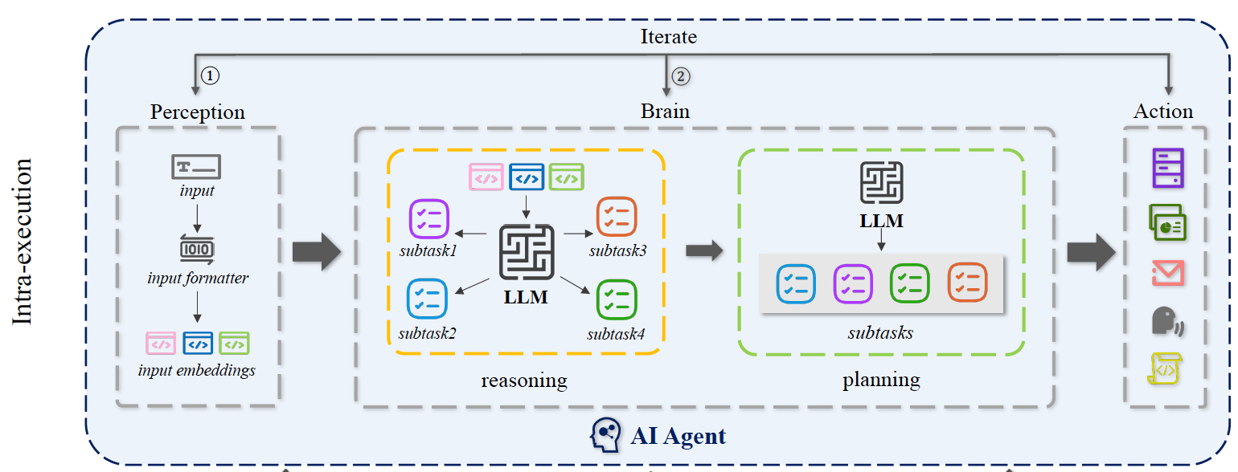
Conceptual Framework of AI Agent

Slide 22
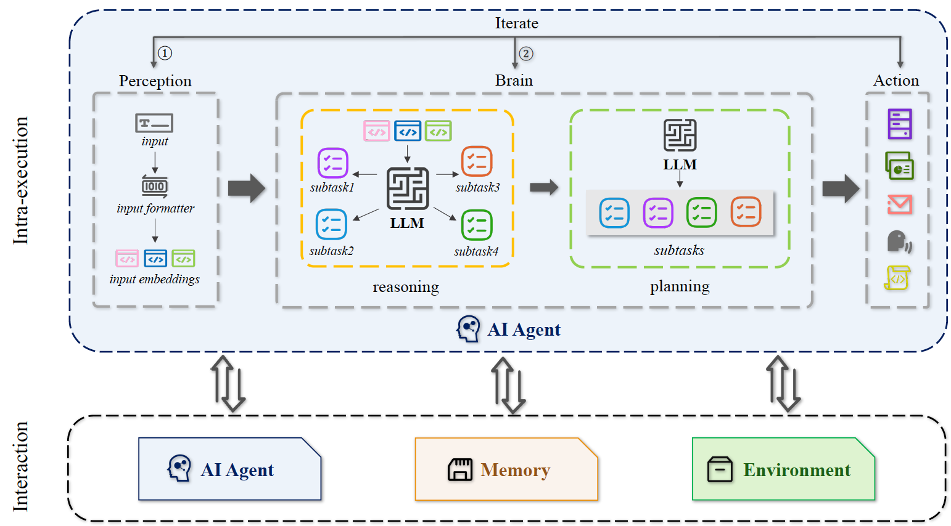
Conceptual Framework of AI Agent
Notes:
AI agents can interact with other agents, memories, and environments.

Slide 23
Tools
Three primary types of tools that Google models are using:
Extensions
Functions
Data Stores

Slide 24
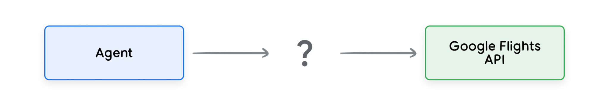
Tools
Directly call a third-party API?
“I want to book a flight from New York to Buffalo”

Slide 25
Tools
Directly call a third-party API?
“I want to book a flight from New York to Buffalo”

Slide 26
Tools
Directly call a third-party API?
“I want to book a flight from New York to Buffalo”

Slide 27
Tools
Directly call a third-party API?
“I want to book a flight from New York to Buffalo”

Slide 28
Tools
Directly call a third-party API?
“I want to book a flight to Buffalo”

Slide 29
Tools
Directly call a third-party API?
“I want to book a flight to Buffalo”
The API call would fail without the required data
More code would need to catch edge and corner cases
Not scalable

Slide 30
Tools
Extension:
Bridges the gap between an agent and an API by:
Teaching the agent how to use the API endpoint using examples
Teaching the agent what arguments or parameters are needed

Slide 31
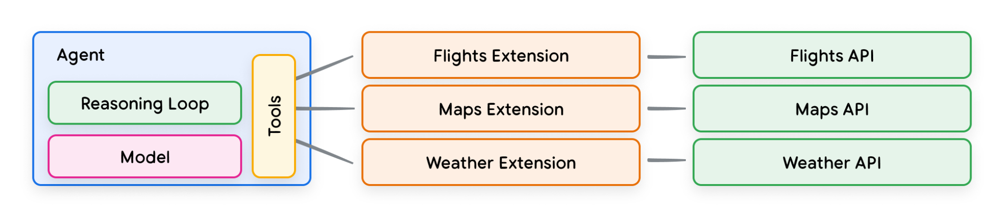
Tools
Extension:
An agent uses the model and examples at run time to decide which Extension to be use.

Slide 32
Functions
A model can take a set of known functions and decide when to use each Function and what arguments it needs.
Functions vs Extensions:
A model outputs a Function and its arguments, but doesn’t make a live API call
Functions are executed on the client-side, while Extensions are executed on the agent-side

Slide 33
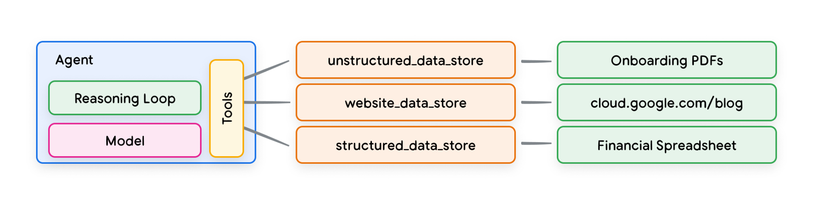
Data Store
Data stores allow developers to provide additional data in its original format to an agent, eliminating the need for time-consuming data transformation, model retraining, or fine-tuning.
It converts the incoming document into a set of vector database embeddings that the agent can retrieval the information it needs.
Retrieval Augmented Generation (RAG) based application

